Slide 1
A Predictive Model for Capital Bikeshare Demand
Robert Kraig
November 3, 2016

Slide 2
Outline
Motivation
Data
Model Selection
Investigation of Results
Web Application

Slide 3
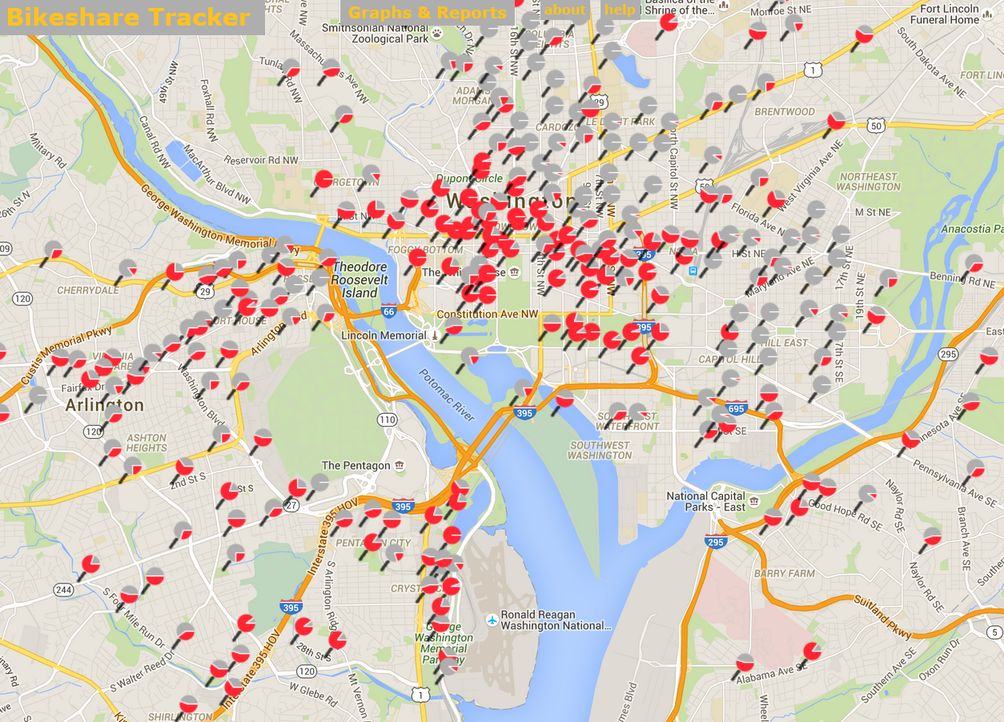
Motivation
CaBi is capacity-limited
Dock-Blocking –> Outages
Outages -> Loss of Customers
Mitigation Strategies
Examples
Rebalancing
Corrals
Infill Expansion
Alternative pricing schemes
All rely on understanding customer demand
Can we use existing data to predict demand?
Predictive Modeling
What data are available? Which predictors are informative?
How well can we predict demand?
Visualization by Daniel Gohlke (CaBi Tracker)

Slide 4
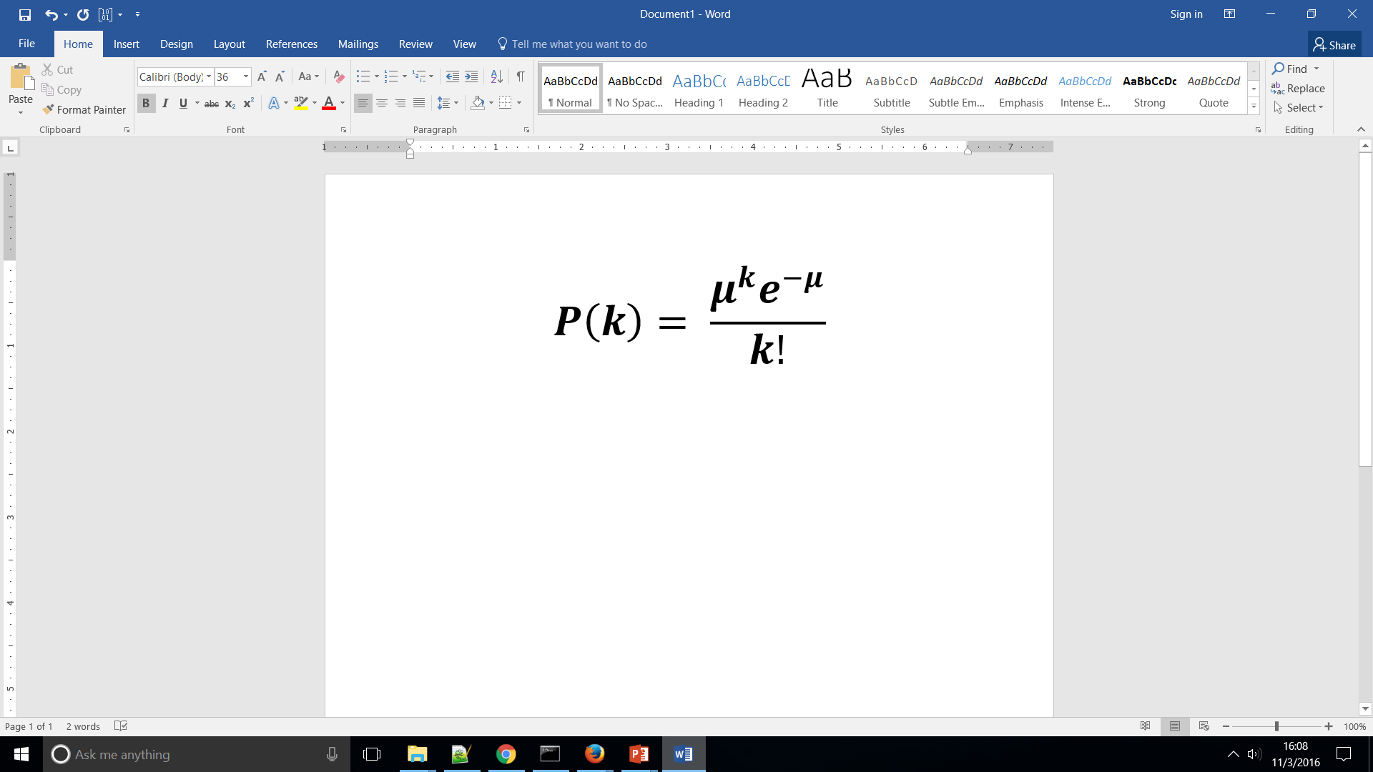
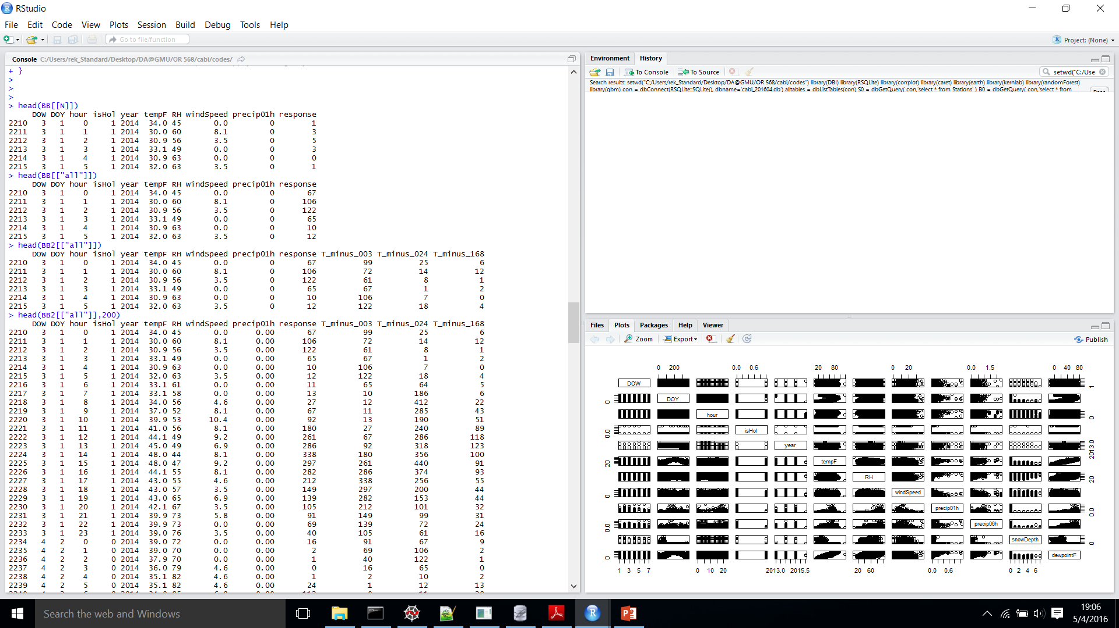
Data and Problem Formulation
Available Data
Trip History (CaBi)
List of 12M rides 2010--
Begin/End Location/Time, Member Type
Weather (DCA)
Geographic info (multiple sources)
Station Lat/Long/Elevation
Jurisdiction / Neighborhood / etc.
Dock Status History (webscraped)
How to select predictors?
Remove variables that are likely irrelevant (e.g. Bike id #)
Remove highly correlated predictors (e.g. 6hPrecip, dewpoint)
Add temporal predictors that seem relevant (e.g. Day of Week)
Try adding observations of response in previous time bins
How to represent response (demand)?
Poisson process
Single parameter: Expected # Customers Arriving in Time Window: μ
Drifting μ
Binned by hour
Regression Models predict μ for each Station and demand type
Base Predictors
Auto-Correlation Predictors

Slide 5
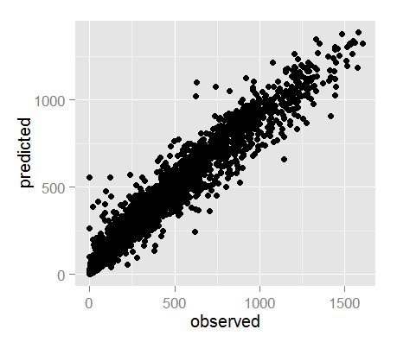
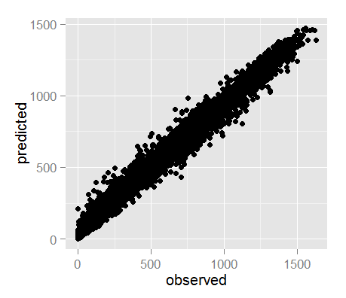
Model Selection: Random Forest w/o Auto-Corr
System-wide bicycle demand,
No auto-correlation predictors:
Test Set Performance, Random Forest w/o auto-corr:
 |  | XVAL | XVAL | TRAIN | TEST
 | Tuned Params | RMSE | SD | RMSE | RMSE
KNN | k=5 | 183 | 4 | 145 | 178
MARS | nprune=18,degree=2 | 174 | 5 | 173 | 171
Random Forest | not tuned: mtry=3 | 91 | 2 | 44 | 82
SVM | sigma=1,C=2 | 162 | 6 | 121 | 158
 |  | XVAL | XVAL | TRAIN | TEST
 | Tuned Params | R2 | SD | R2 | R2
KNN | k=5 | 0.71 | 0.01 | 0.82 | 0.72
MARS | nprune=18,degree=2 | 0.74 | 0.01 | 0.74 | 0.75
Random Forest | not tuned: mtry=3 | 0.93 | 0.00 | 0.99 | 0.95
SVM | sigma=1,C=2 | 0.78 | 0.01 | 0.88 | 0.79
Train Set Overfit, Random Forest w/o auto-corr:
System-wide bicycle demand,
With auto-correlation predictors:
 |  | XVAL | XVAL | TRAIN | TEST
 | Tuned Params | RMSE | SD | RMSE | RMSE
Random Forest | not tuned: mtry=4 | 89 | 2 | 37 | 81
SVM | sigma=0.1,C=2 | 92 | 4 | 82 | 88
 |  | R2 | SD | R2 | R2
Random Forest | not tuned: mtry=4 | 0.93 | 0.00 | 0.99 | 0.94
SVM | sigma=0.1,C=2 | 0.93 | 0.01 | 0.94 | 0.93

Slide 6
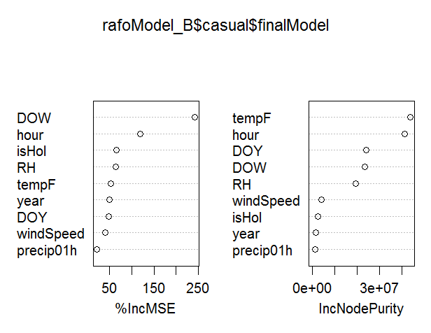
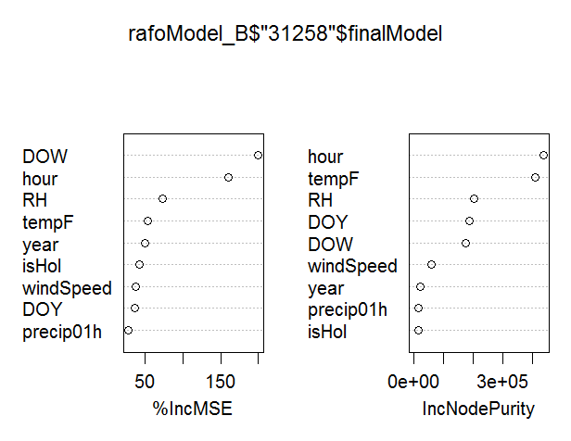
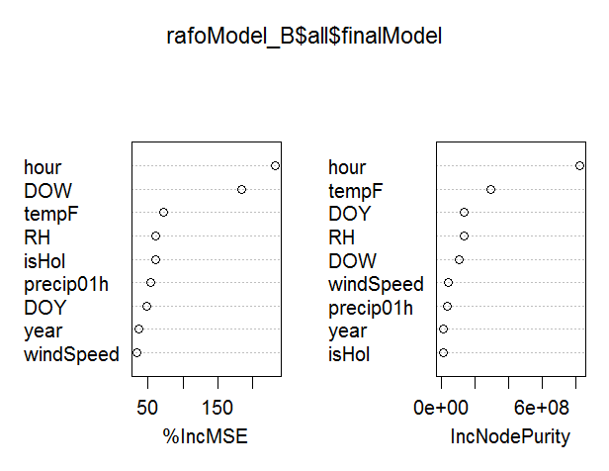
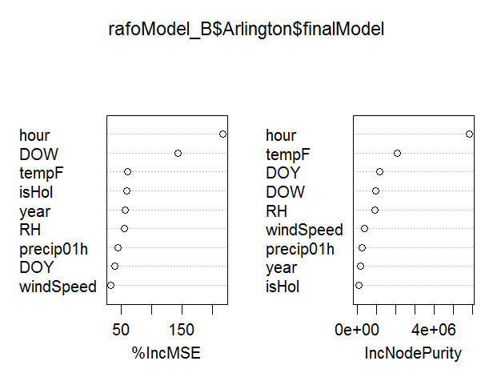
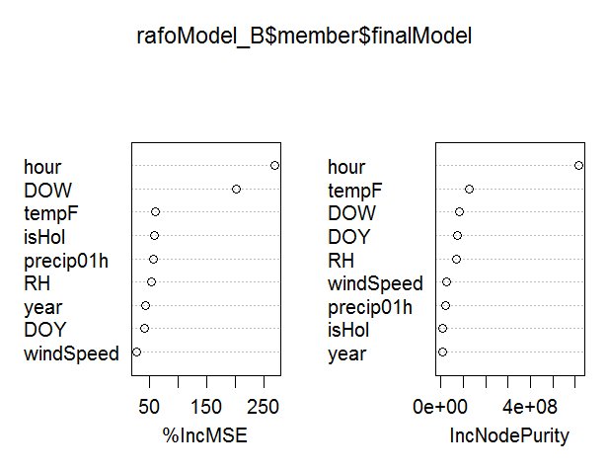
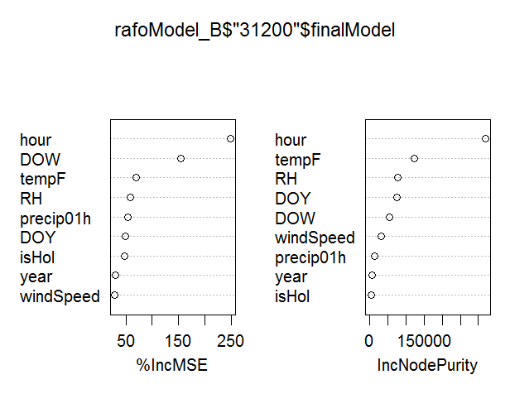
Apply Random Forest to subset Predictions
System-wide bicycle demand,
No auto-correlation predictors:
Casual
Lincoln Memorial
 | XVAL | XVAL | TRAIN | TEST
 | R2 | SD | R2 | R2
all | 0.93 | 0.003 | 0.99 | 0.95
casual | 0.91 | 0.006 | 0.98 | 0.93
member | 0.93 | 0.004 | 0.99 | 0.95
Arlington | 0.89 | 0.004 | 0.98 | 0.91
Lincoln Memorial | 0.76 | 0.007 | 0.94 | 0.78
Dupont Circle | 0.75 | 0.006 | 0.94 | 0.77
Hour is most informative predictor for member ridership; day of week is most informative for casual ridership.
ALL
Arlington
Member
Dupont Circle

Slide 7
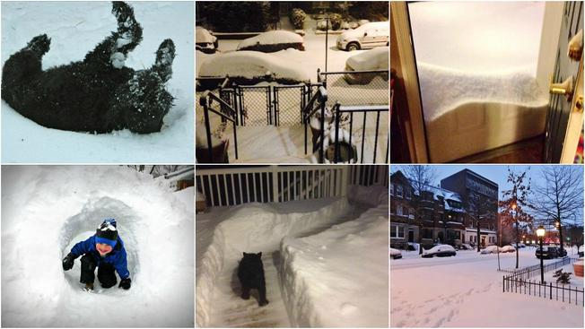
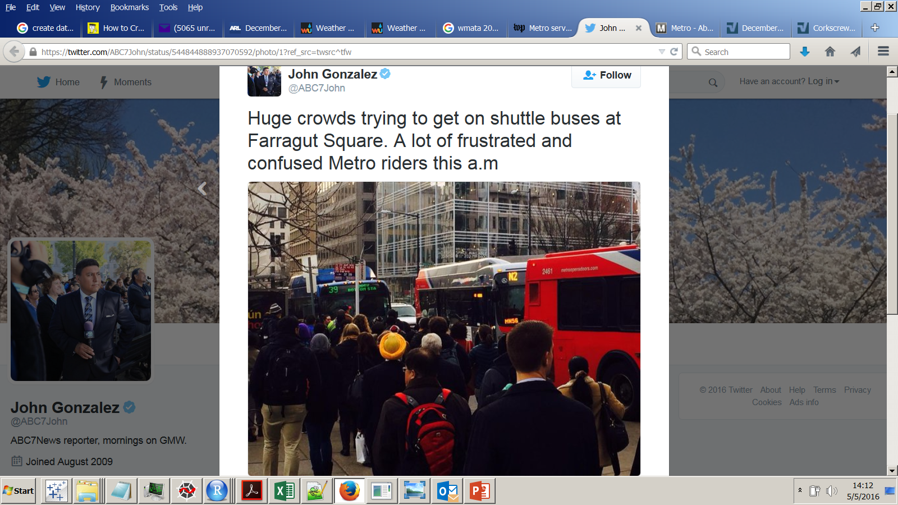
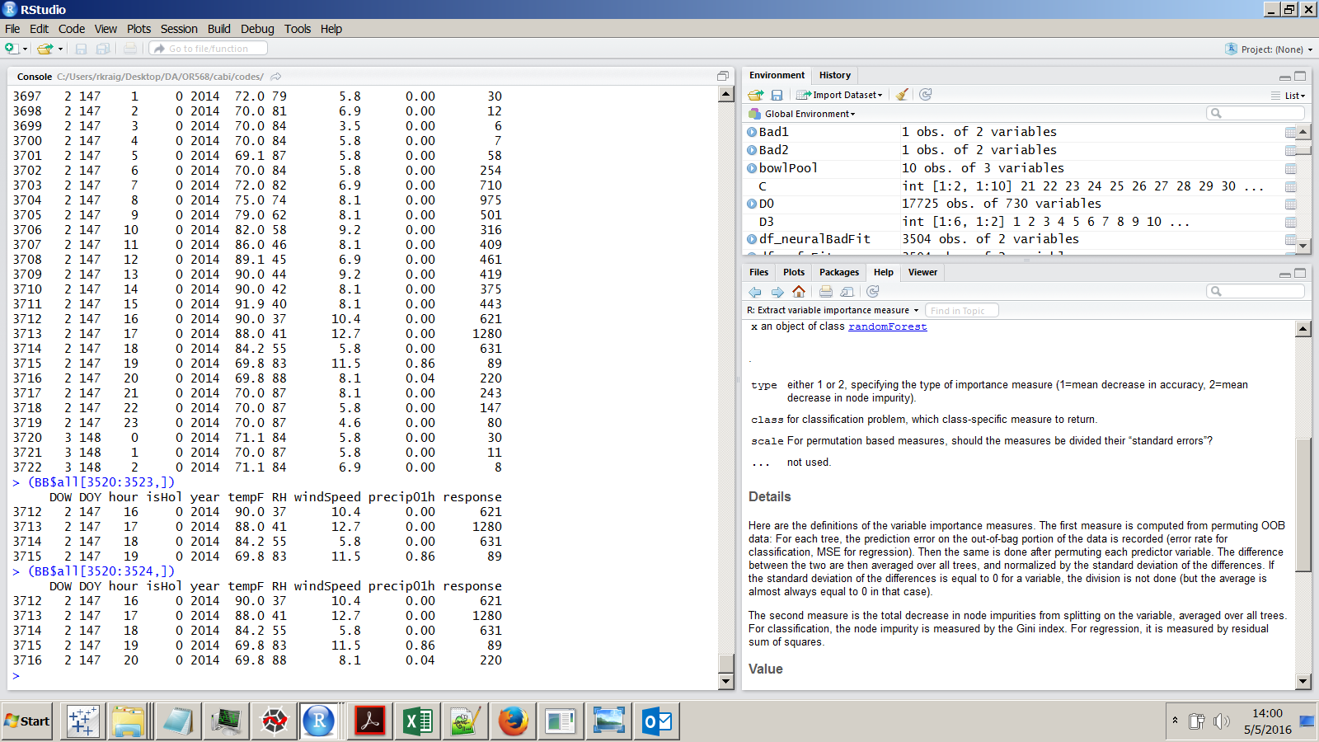
Investigate Worst Misses from 2014 and 2015
3
1
2
1
3
2
4
 | Date | Time | Predicted | Observed |  | Comment
1 | FRI Feb 14 2014 | 8 am | 555 | 0 |  | Day after 6" snow + ice, OPM 2-hour delay (snowDepth predictor removed!)
2 | TUE May 27 2014 | 6 pm | 1099 | 631 |  | right before major thunderstorm (time bins may be too large to capture this effect)
3 | TUE Dec 16 2014 | 8 am | 660 | 1141 |  | water main break at 12th and F, WMATA suspended Silver/Orange/Blue service
4 | THU Oct 01 2015 | 5 pm | 247 | 620 |  | Hurricane Joaquin approaching, rain earlier much of day

Slide 8
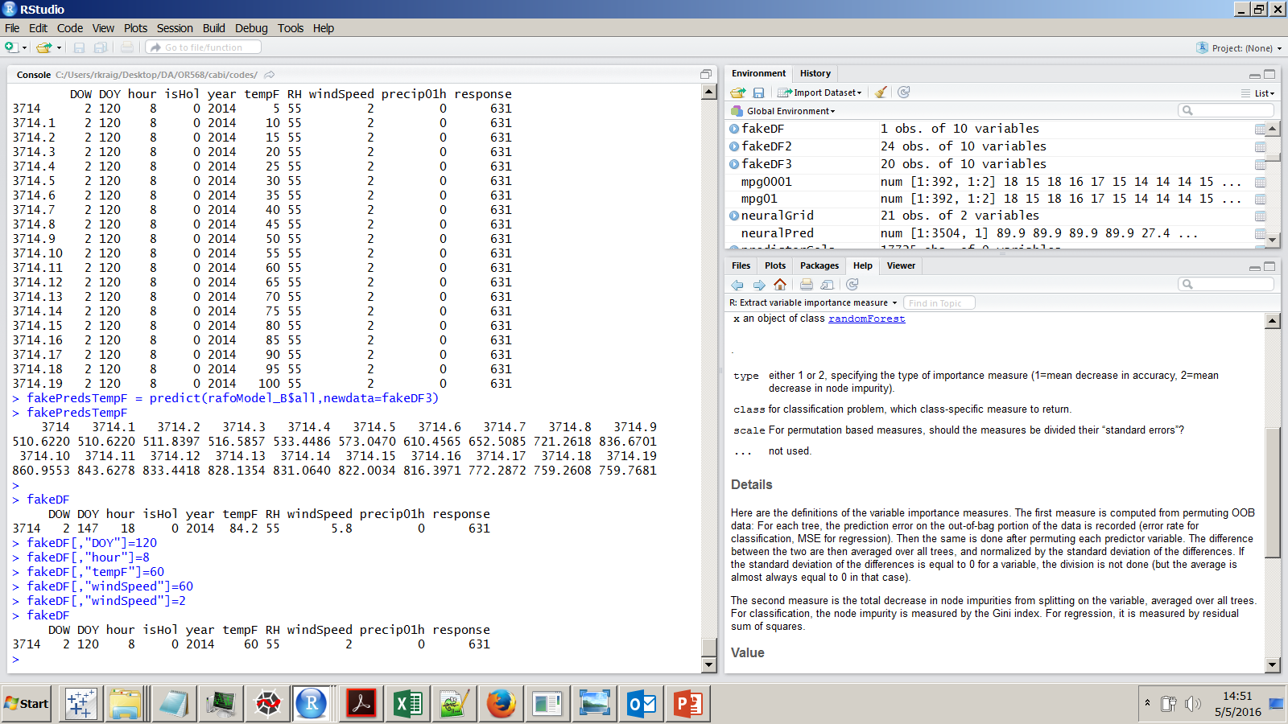
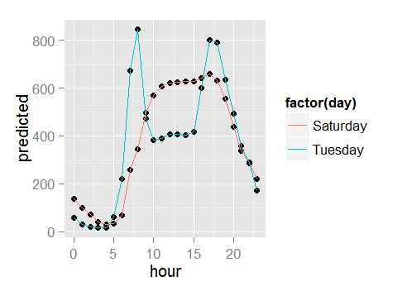
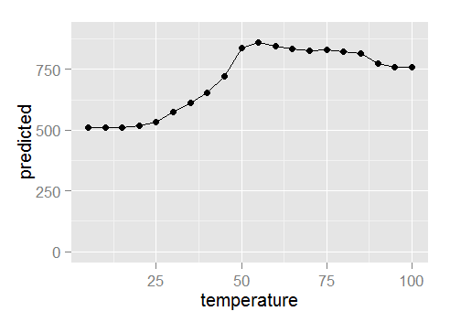
Do regression tendencies make sense?
I simulated data to isolate certain parameters one at a time
Base:
Now vary hour and weekday:
Vary temperature:
Scarce training data below 20º F or above 90º F
Random Forest doesn’t extrapolate.

Slide 9
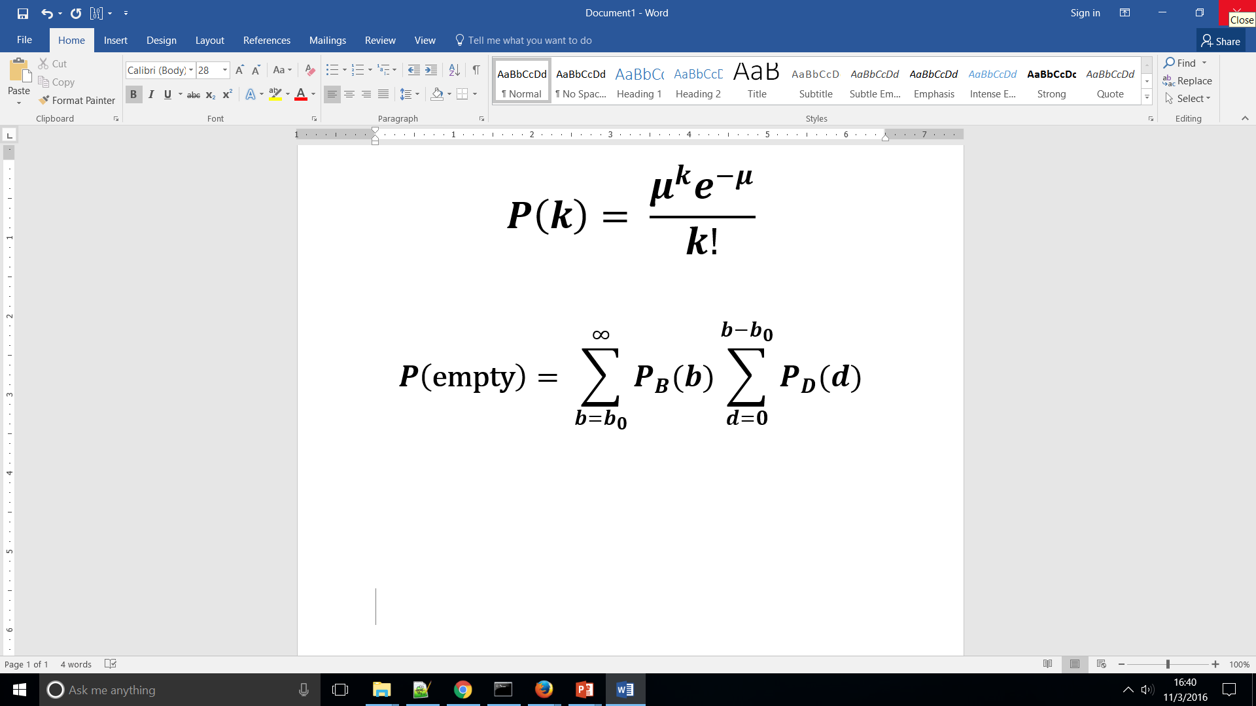
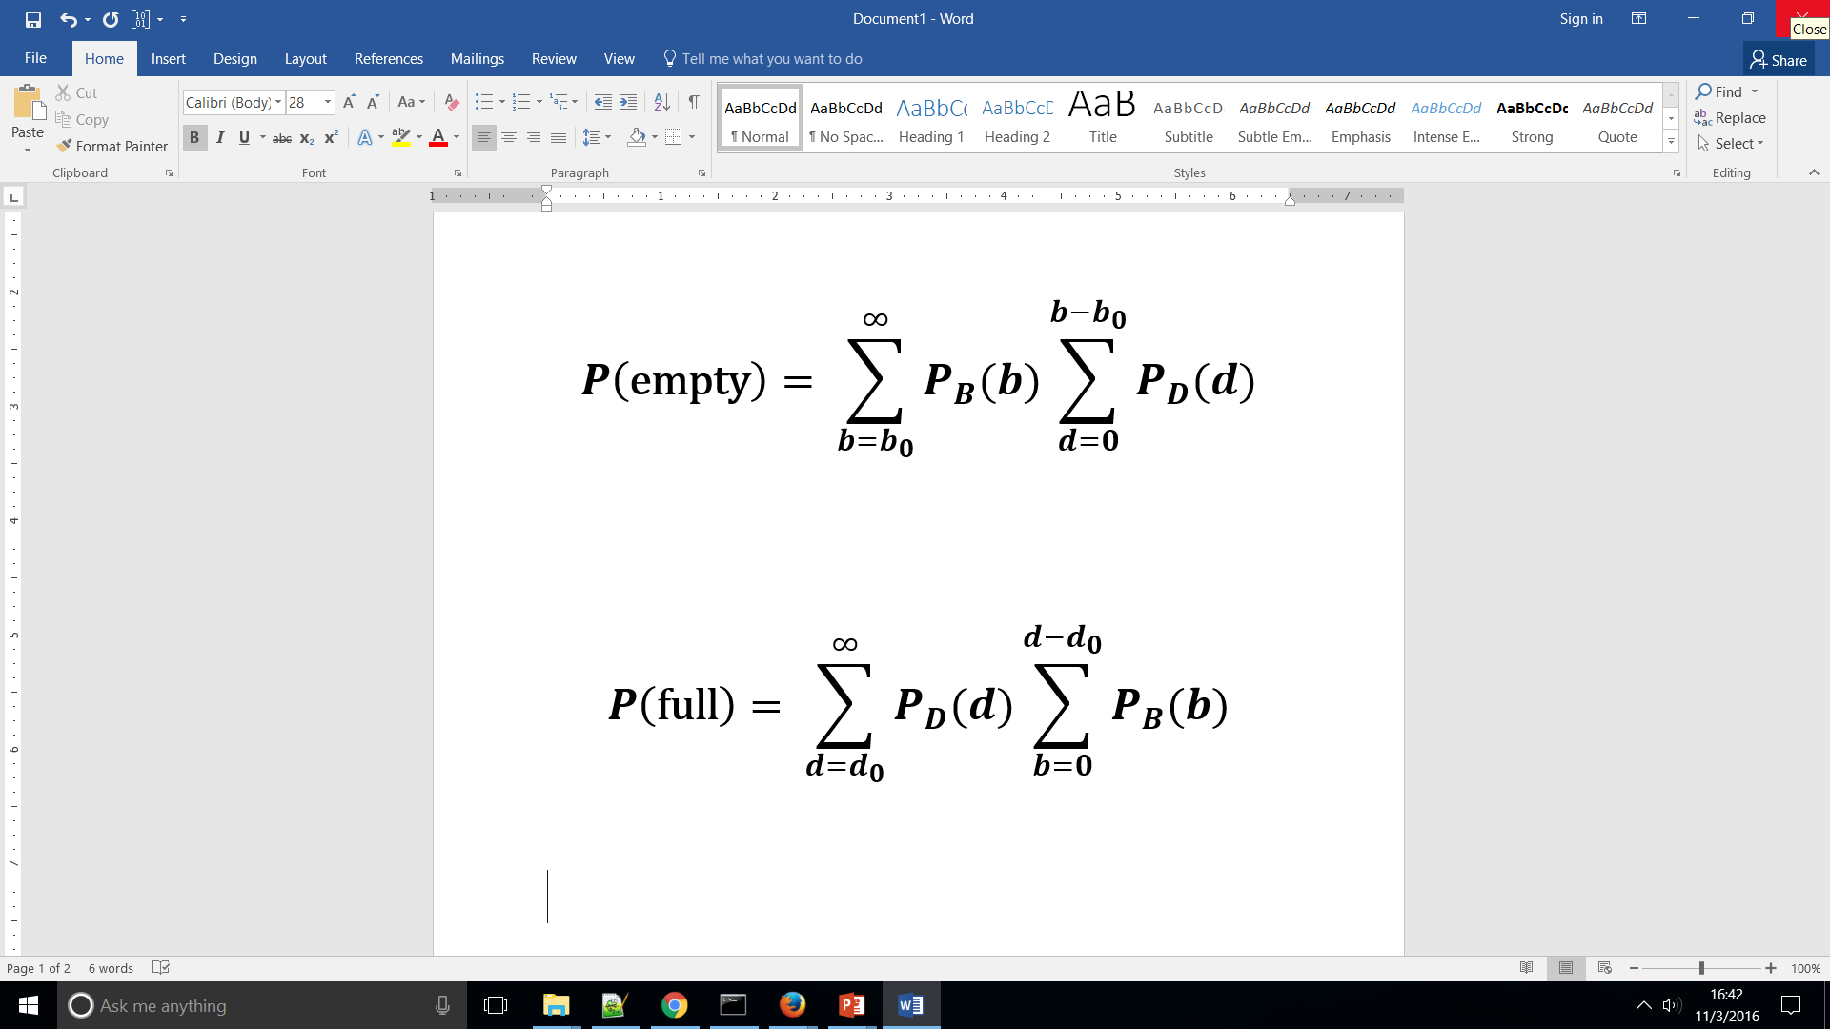
Web Application
By combining demand Predictions with real-time dock status data, one can predict the likelihood of outages in the near future.
Simple Model (ignoring order of arrival):

Slide 11
Backup Slides: Background info

Slide 12
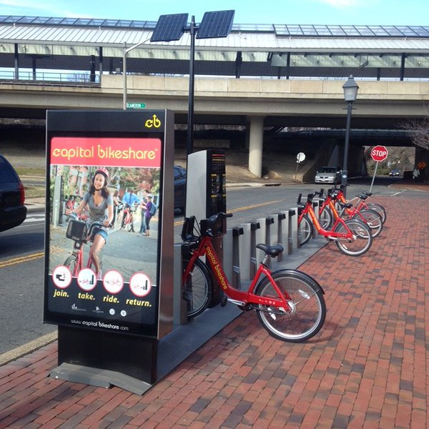
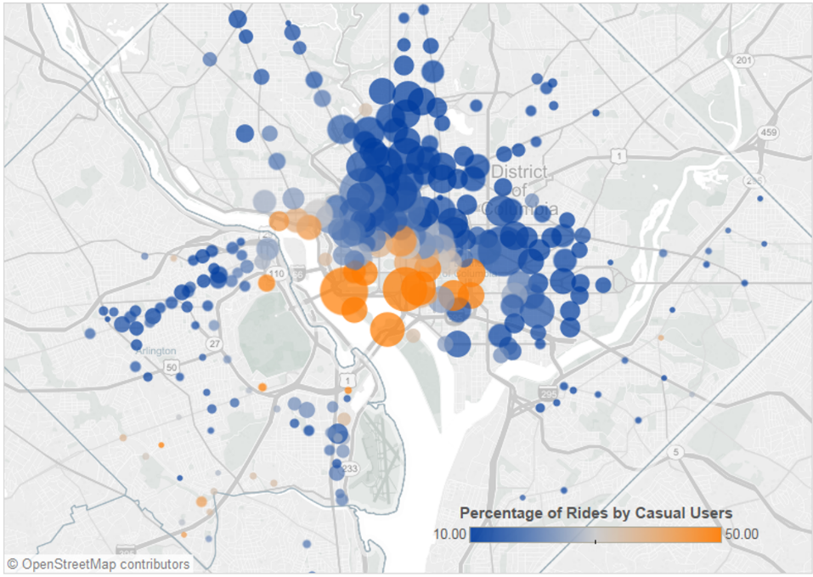
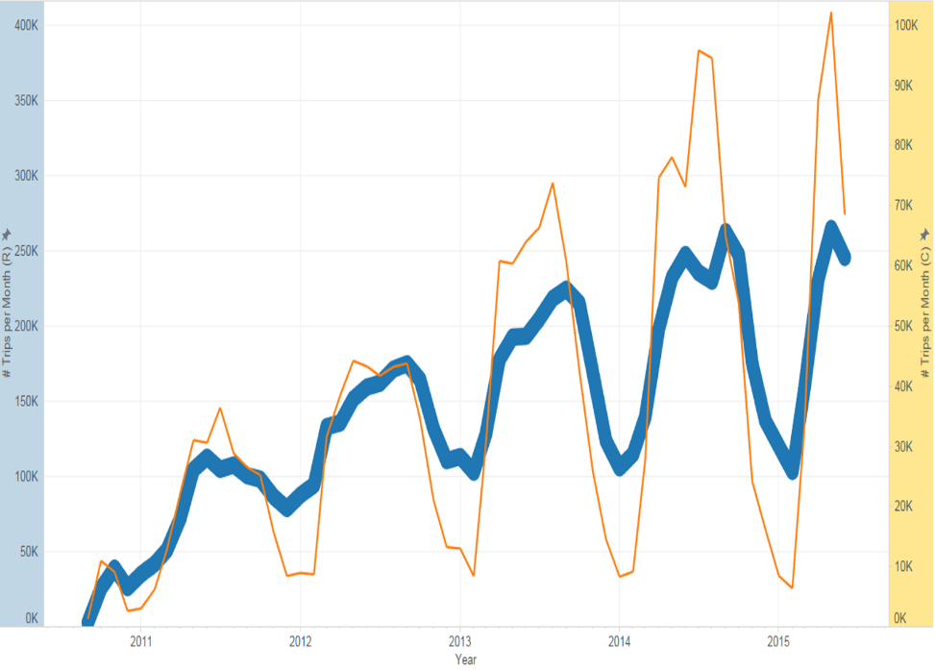
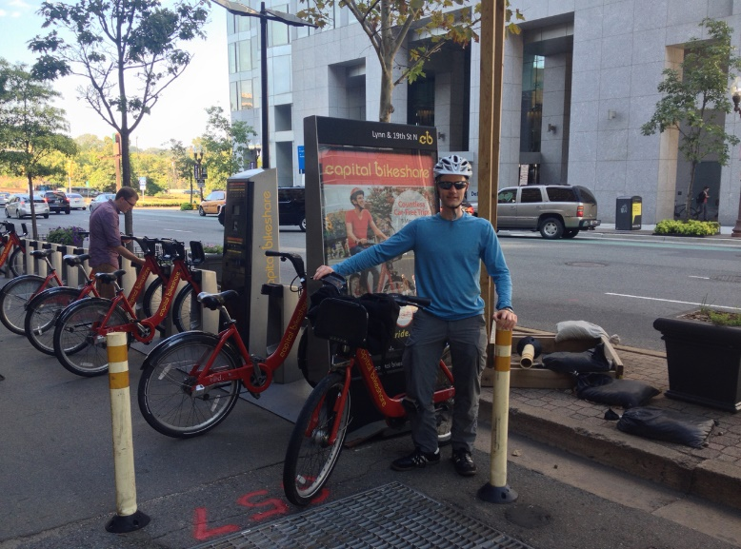
Capital Bikeshare (CaBi)
Self-guided, self-powered public transit
DC / Arlington / Alexandria / MoCo
First station: Crystal City, Sep 2010
360 Stations (10-45 docks each) used in 2014 and 2015
Average = 3-4 blocks between stations
Member Types: Regular and Casual
Relative Ridership Quantity, 2014-2015
Rides per month, 2010-2015

Slide 13
Backup: Data Sources Used in this Project
Capital Bikeshare Trip History
https://www.capitalbikeshare.com/trip-history-data
Click on “Download Links”
Unzip to extract CSVs
The file names and formats are inconsistent from file to file.
The Python code will standardize the data formats, but before running it, you must change all file names to the following naming convention: “2015-Q2-cabi-trip-history-data.csv”. The Python code is expecting that name format so that it knows which files to open.
Weather
http://mesowest.utah.edu/cgi-bin/droman/download_ndb.cgi?stn=KDCA
I downloaded annual files, and manually converted them to CSV
Result: KDCA___csv_mesowest_2010-2015.csv
Geographic Info
Station TerminalName/Name/Lat/Long obtained from https://www.capitalbikeshare.com/data/stations/bikeStations.xml
Station Elevations obtained from Google API at http://www.gpsvisualizer.com/geocoder/elevation.html
Jurisdiction and neighborhood added manually
First use and last use obtained from trip history data
Result: stationInfo_v8.csv
Holiday dates
https://gist.github.com/shivaas/4758439
Added 2010 and 2011 manually
Result: holidays2010on.csv

Slide 14
Backup: Data Munging
Python scripts convert data from original format into a SQL database
R codes begin from SQL database
Notes
Python 2.7
Must put all files into one directory
Must change CaBi trip history file names to the format indicated on slide 11
Line 17 of cabi_Main.py: selects which trip history files to include
Current selection (134,154) selects files between 2013 Q4 and 2015 Q4
First two digits of argument = last two digits of year
Last digit of argument = quarter number
Predictive Modeling
Selected data set only from years 2014-2015
All models used preprocessing (BoxCox/center/scale) except for Random Forest
Discarded many weather fields immediately
Eventually also discarded snowDepth due to near-zero variance
Also Discarded precip06h and dewpointF due to high correlations with other predictors

Slide 15
Summary
Random Forest model predicts system-level bikeshare demand quite well
Tougher to predict at micro-level: SNR is much lower
Most important predictors came out as expected (hour, day of week)
Poor predictions satisfactorily explained by information beyond model
Potential improvements
Better demand metric: account for dockblocked times
More predictors (e.g. snow depth)
Geographic considerations
Treat station locations as numeric lat/long rather than categorical?
Elevation
Time Series techniques?

